Slide 1
ML Importance of Teeth
Dr.Salini Chandran
Dept. of FMT

Slide 2
Forensic odontology
Forensic odontology is a branch of forensic medicine, and in the interest of justice deals with the proper examination, handling and presentation of dental evidence in the court of law.

Slide 3
Identification from teeth
1. Age
2. Sex
3. Race
4. Blood group
5. Occupation
6. Poisoning
7. General facial characteristics

Slide 4
SCOPE AND PURPOSE
antemortem and postmortem dental information.
Collection and analysis of patterned marks (bite marks) on inanimate material or injured tissue.
Recognition of the signs and symptoms of human abuse.
Assessment of the age of the person
Determination of sex of a person

Slide 5
. BASIS FOR DENTAL IDENTIFICATION:
Human Dentition is never same in any two Individuals
The morphology and arrangement of teeth vary from person to person
Dental identity -″total of all characteristics of the teeth and their associated structures which, while not individually unique, when considered together provide a unique totality”
Teeth are relatively resistant to environmental insults after death

Slide 6
Age estimation from teeth
Stage of tooth development has two periods.
1. Pre-natal period
2. Post-natal period.

Slide 7
PRE-NATAL PERIOD
Calcification of tooth starts in incisors at the tips of milky teeth at 5th month of intrauterine phase.
• At time of birth calcification occur-
Incisors
= 2/3 Canines
= 1/3 molars = tip.

Slide 8
Age estimation
1. Eruption of temporary and permanent teeth.
2. Gustafson’s formula.

Slide 9
Eruption of teeth
Two sets of teeth
1.Temporary, deciduous or milk teeth.
2. Permanent teeth.

Slide 10
TEETH
Temporary teeth
These are 20 in numbers (10 in each jaw)
Incisors = 4
Canines = 2
Molars = 4

Slide 11
PERMANENT TEETH
32 in number, 16 in each jaw)
Incisors - 4
Canines - 2
Premolars - 4
Molars - 6

Slide 12
Differences Temporary and Permanent teeth
Temporary teeth | Permanent teeth
Small, narrow & light | Big, broad & heavy
China white in colour | Ivory white in colour
Neck is more constricted | Neck is less constricted
Edges serrated | Edges not serrated
Anterior teeth vertical | Anterior teeth inclined somewhat forward

Slide 13
TEMPORARY DENTITION
Temporary dentition starts at 6 months
completed by 2.5 years
1 year total teeth - 8-12
1.5 year total teeth - 16
Calcification of roots completed by the end of third year.

Slide 14
PERMANENT TEETH ERUPTION
First molars - 6
Central incisors- 7
Lateral incisors - 8
First premolar - 9
Second premolar 10
Canines 11
second molars 11-12
Third molars 17-18 (variable)

Slide 15
Permanent teeth
Successional teeth : Those permanent teeth that follow into a place in the arch once held by primary tooth E.g.-Incisors, Canines, Premolars
Superadded permanent teeth. the three molars of the permanent set, the molars of the deciduous set being replaced by the premolars of the permanent set.

Slide 16
Period of mixed Dentition
The period during which both primary & permanent teeth are together in the oral cavity
Period of mixed dentition is 6 – 12 years.

Slide 17
Permanent teeth
If the 4 wisdom teeth are present, then the age is > 17 years
• Calcification of roots is completed within 3-4 years of eruption.

Slide 18
GUSTAFSON`S METHOD
This method is used for age estimation in adults by studying the age (progressive) changes in an individual tooth.

Slide 19
Gustafson`s criteria
1. Attrition (wearing off teeth )
2. Periodontosis
3. Secondary dentine formation
4. Cementum deposition.
5. Root resorption
6. Root transparency.

Slide 21
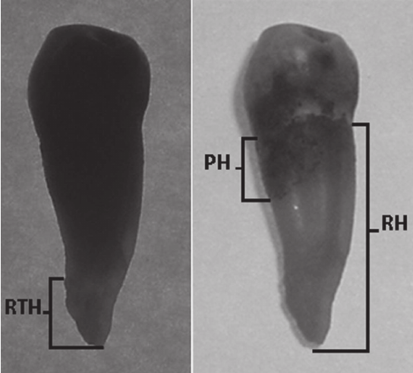
GUSTAFSON’S METHOD
Secondary cemetum
Root Transparency

Slide 22
transparency of root is most reliable criteria

Slide 23
Gustafson`s criteria
Total score – A+P+S+C+R+T
Age (years) = 11.43+4.56 X (total score)

Slide 24
AGE ESTIMATION
BOYD ( 1963 ) devised age from incremental lines of enamel.
These lines can be seen on histological section of teeth and represent daily increments of growth.
A well marked line known as NEONATAL LINE, is formed at birth.

Slide 25
RACE FROM TEETH Mongoloids
1. Shovel shaped upper incisors.
2. Enamel pearls: are small nodules of enamel on the surface.
3.Taurodontism ( bull tooth): the pulp cavity of molars is wide and deep and the roots are fused and bent.
4 Congenital lack of third upper molars is common.

Slide 26
Common identifying features of teeth
Faulty development
undersized (small)
oversized
notched
or present some other irregularities as a result of faulty development and malformation.

Slide 27
Identifying features of teeth
2. Faulty alignment the defect in the alignment
In the space b/w the teeth
eg. Widely spaced teeth, overriding teeth
b/w the teeth of upper and lower jaw.

Slide 28
Stains
Pan (betel leaf, tobacco) chewing habit stains the teeth with dark brown or black deposit.
Yellowish or dark brown stains on the back of incisor teeth are common in cigarette smokers.

Slide 29
Identification from teeth
Chalky white or yellowish brown areas of discoloration on enamel, - Flurosis.
COPPER causes green, and MERCURY and LEAD causes blue-black line on the gums.
PHENYTOIN induces hyperplasia of gums

Slide 30
Localised attrition: Pipe smokers may have localized wear off teeth, either on incisors or at the angles of the mouth due to position of pipe.
Notched incisors from holding thread and pins b/w teeth suggest that person was tailor or hair-dresser or a cobbler.

Slide 31
IDENTIFICATION FROM DENTAL DNA
Teeth are an excellent source of DNA
Applied technique → polymerase chain reaction- allows amplification of highly degraded DNA.
This facilitates comparison with a known biological antemortem sample of the decedent such as hair from a comb, epithelial cells from a toothbrush or biopsy specimen. •
Advantage: - DNA pattern can be compared to the parents or siblings, thus facilitating positive identification

Slide 32
Identification from teeth
Blood group – tissues of pulp
Determination of sex from teeth
Sex – tissues of pulp
Sex determination by DNA analysis Amelogenin (AMEL) – Major matrix proteins secreted by the ameloblasts of the enamel
Metrics of teeth

Slide 33
Teeth bite marks
In a bite mark comparison, you are looking for and matching unique features between the bite mark and exemplar castings.
There are over 20 different methods of bite mark analysis.

Slide 34
Teeth bite marks
WHAT IS A BITE MARK
An injury in skin caused by contacting teeth (with or without the lips or tongue) which shows the representational pattern of the oral structures.
WHY ARE BITE MARKS USEFUL?
We can use bite marks to carry out bite mark analysis. i.e. a comparison of a known person’s dentition to a patterned injury which appears consistent with a bite mark

